Slide 1
Curriculum Leaders Meeting
September 2023

Slide 2
Dr. Randy Watson
Kansas Commissioner of Education

Slide 3
KSDE – DLS Updates

Slide 4
Early Childhood
Amanda Petersen

Slide 5
Kindergarten Readiness Snapshot (ASQ)
Amanda Petersen (apetersen@ksde.org) and Stacy Clarke (kansasicc@ksde.org)

Slide 6
Why do we have a Kindergarten Readiness Snapshot?
The first five years of a child’s life are an incredible opportunity to set a positive direction.
When children, families, schools and communities are ready for kindergarten, students experience greater success in school.
Engaging families to better understand children’s development can improve school readiness.

Slide 7
Why did Kansas decide to use the Ages & Stages Questionnaires (ASQ)?
The ASQ engages parents and caregivers in completion.
The ASQ is a valid, reliable tool well-supported with resources for implementation.
The ASQ addresses developmentally appropriate milestones across a range of domains.
The ASQ is a tool used across age ranges and settings.

Slide 8
What is required?
K.A.R. 91-31-32. Kansas education systems accreditation.
(Excerpt – subsection g) Each education system seeking accreditation shall meet the following requirements:
  (1) Participate in the Kansas assessment program as directed by the state board;
  (2) have in place a method of data collection approved by the state board for collecting kindergarten-entry data;
  (3) have in place a state board-approved individual plan of study program for each student. The program shall begin for all students by grade eight and continue through high school graduation;
  (4) have in place a method of assessing all students' social-emotional growth;
  (5) provide evidence that the foundational structures for each accreditation cycle are in place;
  (6) offer curricula that allow students to meet the requirements of the state scholarship program;
  (7) offer subjects and areas of instruction approved by the state board that provide each student with the opportunity to achieve at least the capacities listed in K.S.A. 72-3218, and amendments thereto; and
  (8) document the existence, membership, training, and meetings of school site councils, education system site councils, and education system leadership teams.

Slide 9
2023-2024 Snapshot
Kansas elementary schools partner with parents and caregivers of incoming kindergarten students to complete both the Ages & Stages Questionnaires®, Third Edition (ASQ-3), and the Ages & Stages Questionnaires®: Social-Emotional, Second Edition (ASQ:SE-2).
All accredited schools must administer the ASQ by Sept. 20, 2023. All data must be entered into ASQ Online by Oct. 10, 2023.
KESA Guidance Document: System is “In Compliance” if it completes both the ASQ-3 and the ASQ:SE-2 for 50% or more of incoming kindergarten students. “Working Towards” is 25% to 50% participation, and “Not in Compliance” is less than 25%.

Slide 10
Discuss with your table:
Agree or disagree: The Kansas Kindergarten Readiness Snapshot is a worthwhile approach to improve student outcomes in my district.
Do you have feedback, ideas, or questions about the way Kansas has implemented the requirement that each education system seeking accreditation in Kansas shall… have in place a method of data collection approved by the state board for collecting kindergarten-entry data?

Slide 11
What would be helpful?
Reports in AMOSS and template ASQ results Powerpoint

Slide 12
What we’re envisioning for AMOSS:
Building and district participation rates:
  Count of total kindergarten students enrolled
  Count of kindergarten students exempt (child older than age cutoff or determined screening was inappropriate)
  Number and percentage with complete ASQ-3, complete ASQ:SE-2, and both
Child-level participation list
Building and district aggregate Kindergarten results
Reports would not be available until December/January timeframe

Slide 13
ASQ-3 and ASQ:SE-2 Results, All Ages
January 1 to Dec 31, 2022

Slide 14
ASQ-3 and ASQ:SE-2 Results, All Ages
January 1 to Dec 31, 2022

Slide 15
This PowerPoint template includes aggregate statewide ASQ results (all ages) and instructions to add slides with district-specific results. Email Amanda Petersen (apetersen@ksde.org) with questions.

Slide 16
Preparing and pulling data
At the state level, we created the charts in this PowerPoint using the “ASQ-3 Aggregate Results, by Category” and the “ASQ:SE-2 Aggregate Results” reports. We have also recreated these reports using a cleaned, analyzed dataset that includes only kindergarten data with one screening per child.
Make sure that ASQ data is finalized – all pending Family Access screenings are accepted and all “in progress” paper screenings are finalized – before running reports.

Slide 17
Format data in Excel as follows:
 | Met benchmarks (Above Cutoff ASQ-3 /Below Cutoff ASQ:SE-2) | Monitoring | At-risk | Total (SUM of the three columns) |  |  | Met benchmarks | Monitoring | At-risk
 |  |  |  |  | For these cells, each percentage is a formula – using the numbers to the left, divide the category “met benchmarks” by the total for that domain. | For these cells, each percentage is a formula – using the numbers to the left, divide the category “met benchmarks” by the total for that domain.
ASQ:SE-2 Social-Emotional | 7,669 | 752 | 520 | 8,941 |  | ASQ:SE-2 Social-Emotional | 86% | 8% | 6%
Personal-Social | 12,128 | 1,382 | 814 | 14,324 |  | Personal-Social | 85% | 10% | 6%
Problem Solving | 12,285 | 1,234 | 795 | 14,314 |  | Problem Solving | 86% | 9% | 6%
Fine Motor | 11,350 | 1,761 | 1,201 | 14,312 |  | Fine Motor | 79% | 12% | 8%
Gross Motor | 12,321 | 1,184 | 790 | 14,295 |  | Gross Motor | 86% | 8% | 6%
Communication | 12,044 | 1,223 | 1,051 | 14,318 |  | Communication | 84% | 9% | 7%

Slide 18
Right-click on the below chart and click “Edit Data” to add district data.

Slide 19
Right-click on the below chart and click “Edit Data” to add district data.

Slide 20
Share your thoughts:
Is providing Kindergarten Readiness Snapshot data in the AMOSS authenticated application in December/January useful?
Would you use a template Powerpoint for ASQ results? What would you like to see included?

Slide 21
End-of-Snapshot reminders
All data is due in the ASQ Online system by October 10.
  Pending Family Access Screenings
  In-Progress Manual Screenings
  Child profiles complete for those not participating because of parent opt-out, older than age cutoff, or determined screening inappropriate
Ensure teachers have ASQ Online accounts and the resources they need to follow up with families to share results.
Amanda Petersen (apetersen@ksde.org) and Stacy Clarke (kansasicc@ksde.org) are available today to answer questions, provide ASQ Online assistance, and help troubleshoot issues.

Slide 22
Contact Information
  Amanda Petersen
  Director
  Early Childhood
  apetersen@ksde.org
  Stacy Clarke
  Consultant
  Early Childhood
  kansasicc@ksde.org

Slide 23
Career and Technical Education
Natalie Clark

Slide 24
Communication
KSDE Secondary-Level CTE Contacts.pdf
CTE - Communications (ksde.org) ListServ Sign-Up
CTE and Perkins Coordinator’s Network Monthly Virtual Meetings
Next Meeting:
Monday, October 23rd, from 1:00 to 2:00 pm CST
https://ksde.zoom.us/j/87325741880?pwd=VTlQNTZzbDJGMjVQaHFpT21oQ1NLZz09

Slide 25

CTE Important Dates
August 15, 2023 – Student Data Management Due
Updated: September 6th for 2023 Year Only
October 15, 2023 – Double-up & Nesting Requests Due
November 15, 2023 – Pathway Applications Open
February 1, 2024 – Student Follow-Up Data Entry Opens
February 15, 2024 – Pathway Course Records Submitted in KCCMS
March 1, 2024 – Pathway Applications Due
April 15, 2024 – Student Follow-up Data Due
May 15, 2024 – Student Data Management Opens

Slide 26

Policy on Combining CTE Courses
Double-up courses
Survey link: https://ksde.sjc1.qualtrics.com/jfe/form/SV_egmgvP6OJyXZ85E
Integrated courses
Survey link: https://ksde.sjc1.qualtrics.com/jfe/form/SV_0iJAmqFw3V82A6O
Nesting Courses
Survey link: https://ksde.sjc1.qualtrics.com/jfe/form/SV_1C6iTMaTmQyiQ5M
Due Oct 15
POLICY ON COMBINING FUNDING ELIGIBLE CTE COURSES :
Fact Sheet Template (ksde.org)

Slide 27
*NEW* 2023-2024 Completer Definition
A student who has completed a minimum of three (3) secondary level credits in a single CTE pathway, with at least two (2) of those credits being a combination of technical and application-level courses.
A Completer must also earn or complete at least one or more of the following:
Earn an end of pathway assessment/certification for completer status (industry-recognized certification or a passing score on a third-party, end-of-pathway assessment) Earn an Excel in CTE Qualifying Recognized Credential aligned to the Pathway
Earn nine (9) + college hours leading to completion of a certificate or post-secondary program aligned to the Pathway’s Program of Study (postsecondary credits in the relevant career and technical education program or program of study earned through a dual or concurrent enrollment)
Complete a high-quality work-based learning career preparation experience, Kansas Work-Based Learning Continuum, in the Pathway defined in Kansas Work-Based Learning: Personalized Learning Plan Guidance Document (ksde.org)
Place artifacts that demonstrate completion in the electronic portfolio section of the Individual Plan of Study (IPS).

Slide 28
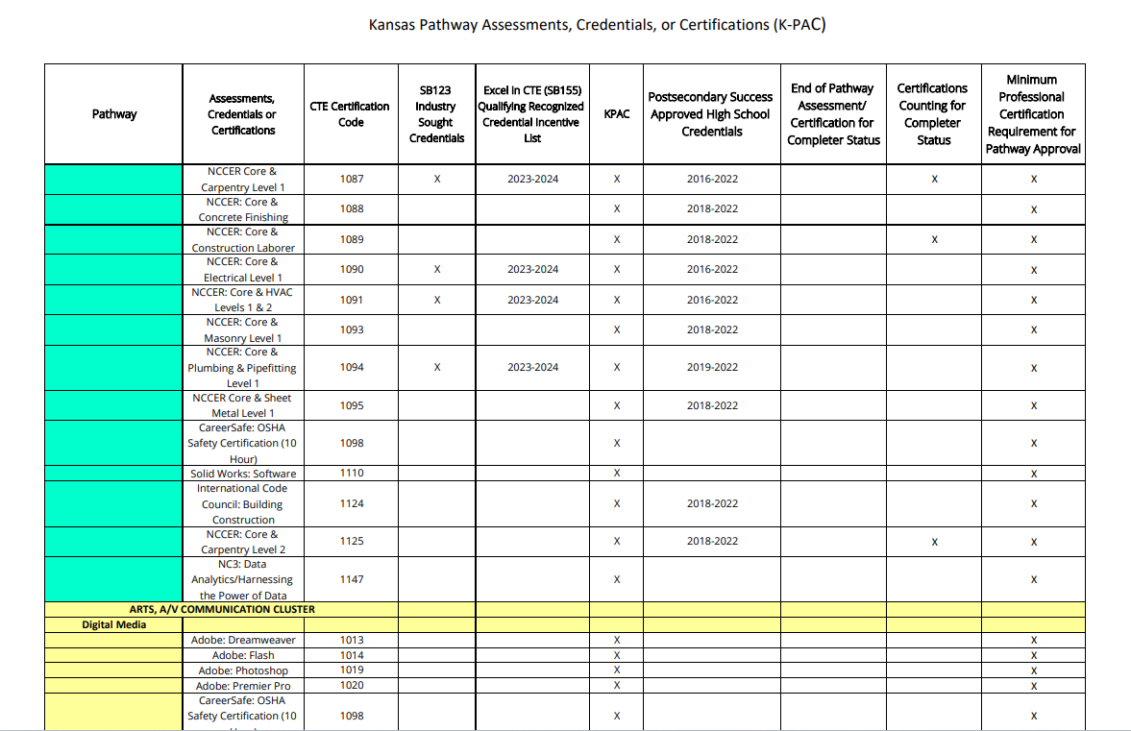
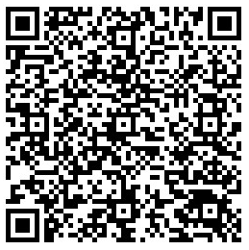

Slide 29
House Sub for Senate Bill 123
Excerpt from HS for SB 123 concerning students in grades 9-12:
Career and Technical Education Credential and Transition Incentive for Employment Success Act
The bill establishes the Career and Technical Education Credential and Transition Incentive for Employment Success Act. The bill requires all school districts and colleges that offer career technical education (CTE) for students in grades 9–12 to, upon request of the student, pay any fees associated with any assessment or examination required for the student to obtain the industry-sought credential associated with the student’s CTE program.
Final_SB123_Credential_List_for_2023-2024.pdf (kansasregents.org)

Slide 30
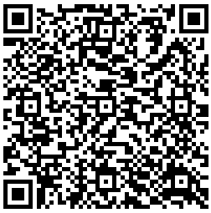
Career and Technical Education (CTE)
Pathway Credential Recommendations
A CTE Pathway Credential Recommendations Link will be Available Year-Round for Pathway Credential Recommendation Submissions in compliance with Senate Bill 123 (New Section 10)

Slide 31
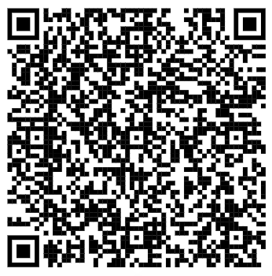
Tiered Technical Courses
What are Tiered Technical / Excel in CTE course?
Post-secondary credits first funded when Senate Bill 155, or the Governor’s CTE bill, was passed into law on July 1, 2012.
Provides free tuition or tuition reimbursement for high school students taking designated CTE courses from post-secondary institutions while in high school.
The goal of this bill is to create a Kansas workforce that is highly skilled and ready for employment.
Students may be financially responsible for fees outside of tuition including technology fees, tools, and textbooks.
Tiered Technical Courses (ksde.org)

Slide 32

Career and Technical Education (CTE)
2023-2024 Cluster Reviews
Lead Consultant Created Last Year Reviewed Next Projected Review
Agriculture, Food and Natural Resources
Architecture and Construction
Arts, A/V Technology and Communications
Education and Training
Engineering
Finance
Health and Bio Sciences
Changes for
2025-26 School Year

Slide 33

Financial Literacy
New
Graduation Requirement
Course Title: Financial Literacy
Course Code: 22990
Course Description: Financial literacy course provides students with an understanding of the concepts, principles and skills involved in making and applying sound financial decisions. This course emphasizes earning income, spending, saving, investing, managing credit and managing risk.
Qualified Teachers: Family and Consumer Sciences, Gen Business, Business Ed Comp, Business Economics, Business Finance, Economics, History and Government, Social Studies Comp (With verifiable Financial Literacy Training)
Notes:
These changes begin with the class of 2028. (Incoming 8th Grade class.)
Follow the FAQ page as questions emerge and answers are provided: New Graduation Requirements FAQ

Slide 34

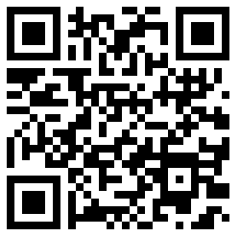

Slide 35

For Educators | HirePaths
Cool Careers Videos | HirePaths
Cool Careers Videos | HirePaths
For Educators | HirePaths

Slide 36
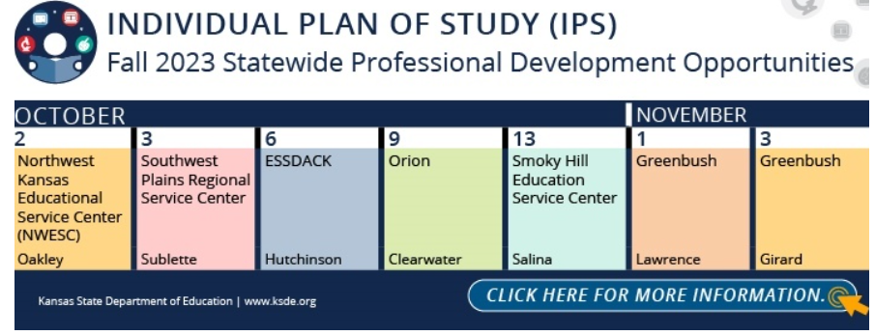
The Kansas State Department of Education (KSDE) will be providing IPS Technical Assistance opportunities in the fall at educational service centers. Fall 2023 Statewide Professional Development (ksde.org)

Slide 37
  Natalie Clark
  Assistant Director
  Career, Standards and Assessment Services
  (785) 296-4351
  ndclark@ksde.org

Slide 38
DGSR
Dr. David Fernkopf
Dr. Robyn Kelso

Slide 39
Dropout Graduation Summary Report (DGSR)
The Dropout Graduation Summary Report (DGSR) provides all schools and districts an opportunity to review and certify their dropout and graduation data are correct before submitting the report to the Kansas State Department of Education (KSDE).
Opens this year, Monday, October 2.
Reminders that all principals should be logging in to the DGSR to look at and check their data.
Due Tuesday, October 31st. If district admin does not sign off, we will be submitting for the district.

Slide 40
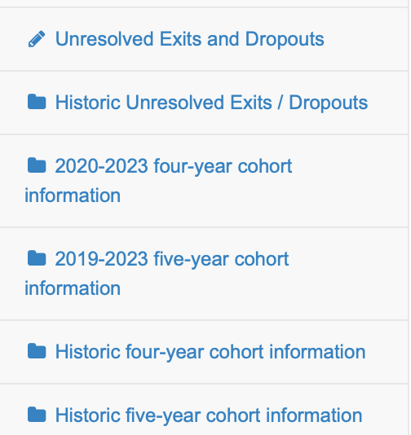
Dropout Graduation Summary Report (DGSR). Few tips and hints
When you are logged into the DGSR anything that is labeled historic data, this data can not be changed. It is from the past year and has already been submitted.

Slide 41
Dropout Graduation Summary Report (DGSR). Few tips and hints
There are tools that districts have access to when working with the state to correct their data.
One of those tools is called special circumstance remove from cohort.
Reminder that we read all these requests and it most be a valid reason to remove the student from the cohort to keep the data accurate. Please use this tool as the directions list.

Slide 42
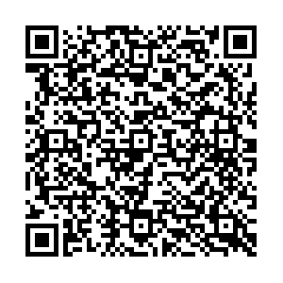
Dropout Graduation Summary Report (DGSR). Few tips and hints
Much more information available on the website and in the DGSR manual.

Slide 43
Dropout Graduation Summary Report (DGSR).
Finally, please encourage your administrators not to wait until the end of the month to submit their reports.
We are here to help if you have any questions.
Dr. Robyn Kelso
Dr. David Fernkopf

Slide 44
Early Literacy/Dyslexia
Melissa Bruner
Amy Bybee

Slide 45

Revised Dyslexia Handbook
ON the KSDE Dyslexia Page:
Dyslexia Handbook
Revised screening protocol
EOYA Guidance document
Every Child Can Read Guidance Document
Notes:
Dyslexia handbook is out and available at the KSDE Dyslexia page.

Slide 46
Initial Dyslexia Training Modules: Revision: by January 2024
(the required annual training requirements remain the same this year)
Introduction to Dyslexia: What it is and What it is Not
How the Brain Learns to Read
Structured Literacy & Structured Literacy Middle/Secondary
Using Information for Transformation
KSDE Requirements and District Expectations
Notes:
These will replace the required dyslexia modules and will come with a facilitation guide and supporting materials

Slide 47
The optional 2nd Grade Reading Test (April)
Well-received with over 3500 students and over 65+ districts participating
A “bridge” assessment between the instructional focus of early literacy instruction and the expectation of a comprehension assessment more typical of the 3rd grade assessment
Allow teachers/ districts to see the effectiveness of core instruction in early grades
Allow schools to see if there are areas to focus on for the shift from learning to read- to reading to learn

Slide 48
PK-16 Partnerships
Unit Head Meetings (IHE)
Revised Assurance Forms (IHE)
Program Review (IHE)
PK-6 Elementary Standards Revision underway
Notes:
Laurie has presented about structured literacy at the unit head meetings for those who lead institutions that prepare teachers. They have been asked to provide revised assurance forms and syllabi as to where SoR is taught and assessed, I participate in program review and approval, PK-6 Elementary Standards are under revision for how you prepare teachers

Slide 49

ONLY 1 MORE YEAR
Increased LETRS Opportunities
One Year Curriculum: LETRS Early Childhood
Two more opportunities for teachers/ systems to join
Two Year Curriculum
Two more opportunities for teachers/ systems to join
Two Year Curriculum for Administrators
Two year opportunity for administrators
Registration open to individual teachers OR building/ district cohorts.
Contact TASN or Kevin Davis: kddavis@pittstate.edu
MORE INFO: LETRS
Notes:
If administrators are coaching and/ or directly supervising teachers using structured literacy, then they should take the regular two year curriculum.

Slide 50
Professional Learning
90 Minute Literacy Block to be recorded
Structured Literacy Tool for Administrators (presented at Fall KSDE Conference)
Middle/ Secondary Students with Characteristics of Dyslexia (Recorded)
Structured Literacy Interventions (Text-based via Zoom Sept-Feb)
Fresh Look at Phonics- Revisited/ (Text-based via Zoom Sept- October)
KSDE Virtual Office Hours (Literacy Lifeline) Thursdays (3:30-5:00 via Zoom)
Provide input HERE

Slide 51
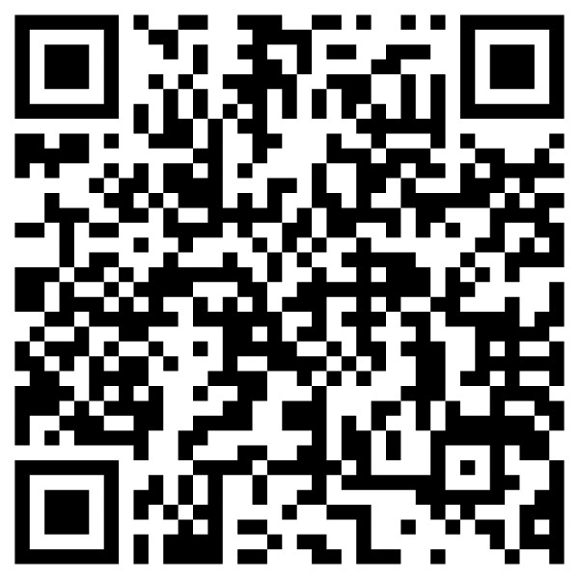

KSDE Dyslexia Page for More Information
Kansas Dyslexia Handbook
KSDE Dyslexia Page
Link to the Early Literacy/ Dyslexia Link/ Newsletter

Slide 52
Questions?
Amy Bybee, KSDE Teacher Leader Consultant
Melissa Brunner, KSDE Teacher Leader Consultant
Early Literacy/ Dyslexia Team
CSAS
(785) 296-2749
lcurtis@ksde.org

Slide 53
Program Manager Updates

Slide 54
School Counseling
Follow the listserv by contacting kreed@ksde.org
The annual ESU/KSDE Fall Counselor Conference is back!! The 71st Fall Conference will be held at Emporia State November 17th from 8:30 am through 2:30 pm. Early registration is $95 and can be completed at ESU Fall School Counseling Conference (touchnet.com).

Slide 55
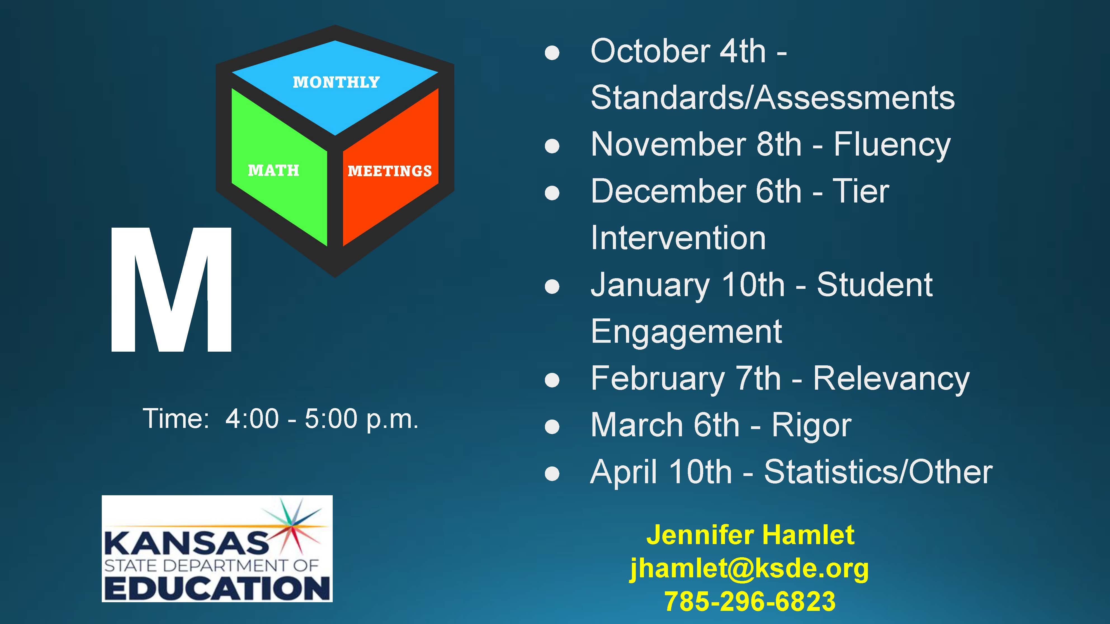

Slide 56
Licensure News
Shane Carter

Slide 57
SETS State Director Report
Bert Moore

Slide 58
HOT TOPICS
Dyslexia – FAQ Document
Dyslexia - Identification Versus Diagnosis
Dyslexia – KSDE Revised Dyslexia Handbook
Dyslexia Resources – ksde.org/Dyslexia

Slide 59
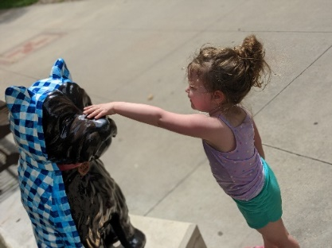
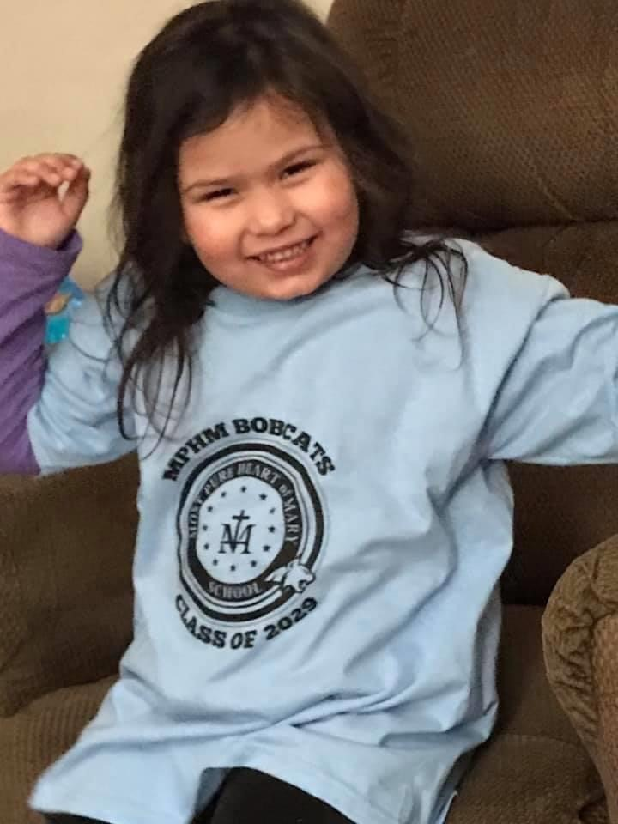
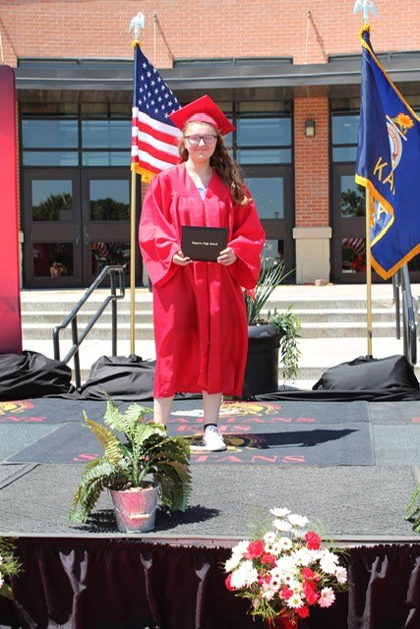
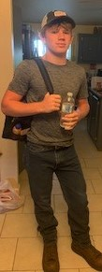
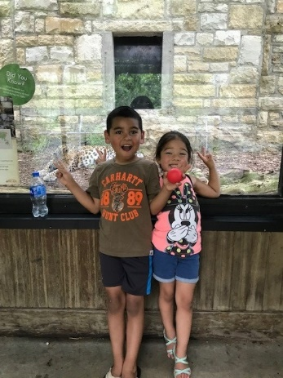
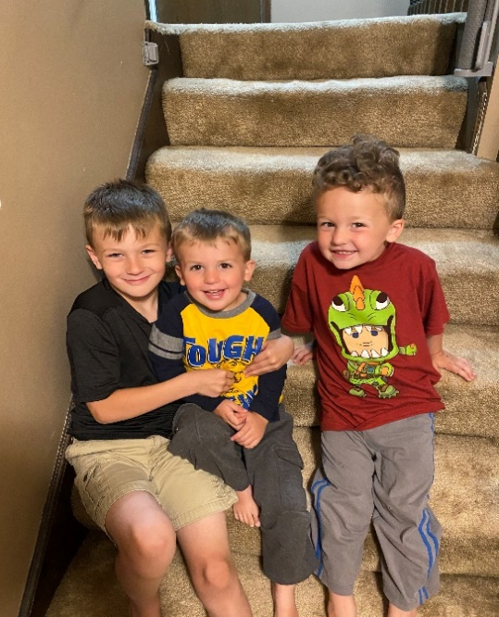
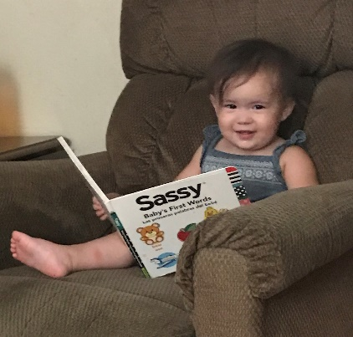
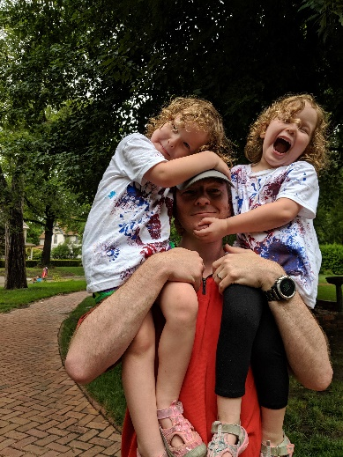
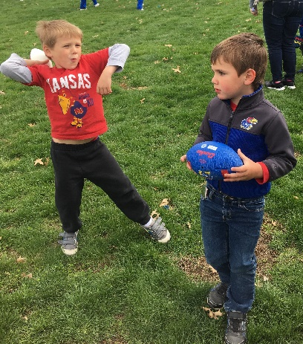
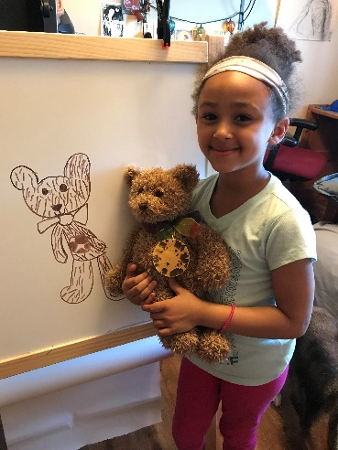
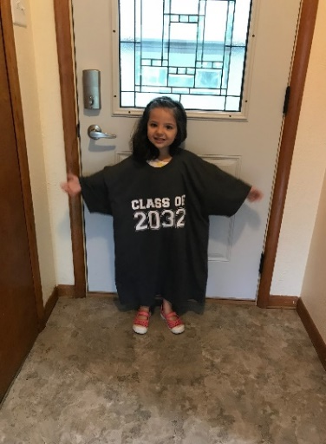

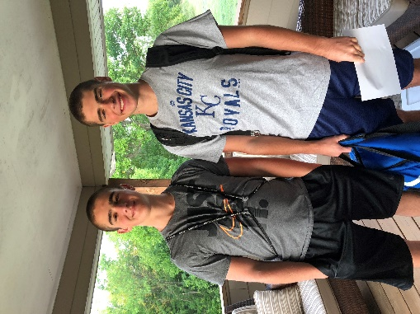
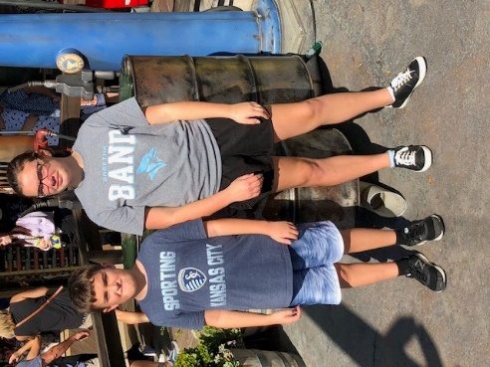
Keep The Main Thing The Main Thing

Slide 60
  Bert Moore
  SETS Director
  (785) 296-4949
  bmoore@ksde.org

Slide 61
Adaptive Schools
Sarah Perryman

Slide 62
DLS Update
Dr. Ben Proctor

Slide 63
KSDE/DLS Update
KSDEWeekly Newsletter
  Subscribe: ksdeweekly@ksde.org
KSDE Great Ideas In Education Conference: Empowered Together
  October 25-27, 2023
  Hyatt Regency and Century II, Wichita
  Registration closes October 13
  Registration Link: https://events.ksde.org/Default.aspx?tabid=771

Slide 64
Lunch

Slide 65
Fundamentals, School Improvement, and Accreditation
Dr. Ben Proctor
Dr. Jay Scott
Accreditation and Design Team Members

Slide 66
Think of something in your life when the mantra “less is more” is a good thing.
Notes:
Jay

Slide 67
Objective for this session
Analyze the potential impact of the next version of accreditation (KESA 2.0).
Notes:
Jay

Slide 68
Why make changes to KESA?
An urgency to improve student outcomes
Focus group feedback – Clarity, Consistency, and Reduce Redundancy
Imbalance in accountability
Practice what we preach
Notes:
Jay

Slide 69
Accreditation and Design Team Vision
EACH SYSTEM,
FULLY ACCREDITED
Notes:
Jay
Fully accredited - a system that has all the essential structures in place so that each student in each classroom has access to a quality learning experience that opens the door to future opportunities.
By 2029

Slide 70
Accreditation and Design Team Mission
To provide support and accountability to 350-plus education systems in order for each system to elevate opportunities and reduce limitations for students.
Notes:
Jay
Build on language of elevating opps and reducing limitations - intentional language connected to SBOE priorities

Slide 71
Accreditation in Kansas is …
And accreditation also is …
A reflection of the priorities of the State Board.
An evaluation of impact systems are making on those priorities.
Built on the premise that a good process leads to good results.
Notes:
Jay
KESA has and continues to be built on premise that a good process leads to good results
Currently KSDE is re-prioritizing
Challenging conversations around priorities, including what they are, how we will support systems implementing, how they will be evaluated.

Slide 72
Accreditation Timeline
Accreditation legitimized, Narrative-based report
Evaluation of KESA’s Impact
Feedback and Build of KESA 2.0
2017-2018
2022-2023
2023-2024
2024-2025
KESA 1.0 ends
Learning Year
KESA 2.0
KESA Begins
Document school system improvement locally, Additional Accreditation checkpoints
TBD
Five R’s
Process, Results, Compliance
Notes:
Jay

Slide 73
Current State – “Learning Year”
A transitional year between the first cycle of KESA and the next version
Allows Systems time and space to learn about and adapt to the changes to both the focus and the process of accreditation
Allows KSDE time and space to collaborate with systems to learn how to most effectively support their improvement efforts
Notes:
Amber

Slide 74
Future State – KESA 2.0
Focus on Fundamentals - Structures – Lead Indicators
Increasing access to support and accountability on a yearly basis
  KSDE
  Peers
  Experts
Clear, Consistent, Reduced Redundancy
Notes:
Myron

Slide 75
Next Meeting, January 19, 2024
Salina

Slide 76
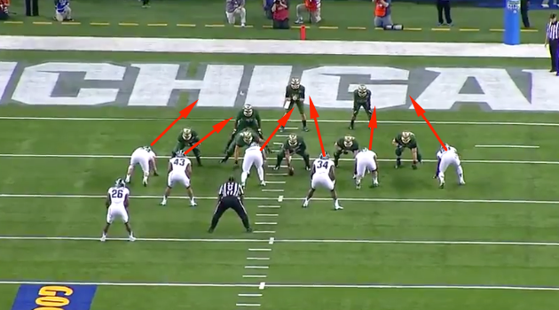
Filling the gaps
Accreditation and School Improvement
Fundamentals and Lag Measures
Notes:
Jay
Gap sound – takes no talent
Accreditation & school improvement – what might be reasons that systems don’t see accreditation synonymous with school improvement?

Slide 77
What, if any, gaps do you perceive between the work of accreditation and the work of school improvement? Please explain.
Notes:
Jay

Slide 78
Improving Execution
You do not rise to the level of your goals. You fall to the level of your systems.
James Clear
Notes:
Jay/Myron
Consistent cadence of accountability (most important aspect of execution)
Plans are useless, planning is indispensable
Accountability partner
At some point, it comes down to who can handle the boredom that comes with doing something fundamental over and over and over every day.

Slide 79
What factors contribute to gaps in execution of the goals outlined in your school system's improvement plan and the actual practices and outcomes observed within your classrooms?
Notes:
Myron
To what degree are the goals in your system’s improvement plan executed on a daily basis in each classroom in your system? What factors contribute to a gap between the goals and what’s actually taking place in classrooms?

Slide 80
Yearly Accreditation Process beg. 24-25
1 on 1 between System and Accreditation & Design team member
Multiple systems attend an in-person accreditation meeting where each system has access to:
  Peer systems
  A team of experts in the Fundamentals who will partner with each system to co-create an Action Plan
Notes:
Amber

Slide 81
Do you believe that this proposed model of KESA 2.0, with a stronger emphasis on fundamental practices and increased yearly access to support, holds greater potential to effectively maximize opportunities and reduce limitations for our students? Why or why not?
Notes:
Amber

Slide 82
  Ben Proctor
  Deputy Commissioner
  Division of Learning Services
  (785) 296-2304
  bproctor@ksde.org

